Slide 1

Plant Disease Predictor
Submitted By:
Anisha Srivastava(190110021)
Priyanshu Chauhan(190110022)
Surbhi Singh(190110023)
Ujjwal Tayal(190110024)
Group ID: IBM19-G17
Major : CSE-CCV
Project Guide :
Ms. Meghavi Rana
Assistant Professor School of computing

Slide 2

Project Overview
Plant diseases and is one kind of natural disasters that effect the normal growth of plants and even cause plant death .
This project will not only help in predicting disease suffered by plant but it will also act as an interactive web application .In this way, prediction of plant disease will become faster as compared to basic laboratory methods.

Slide 3
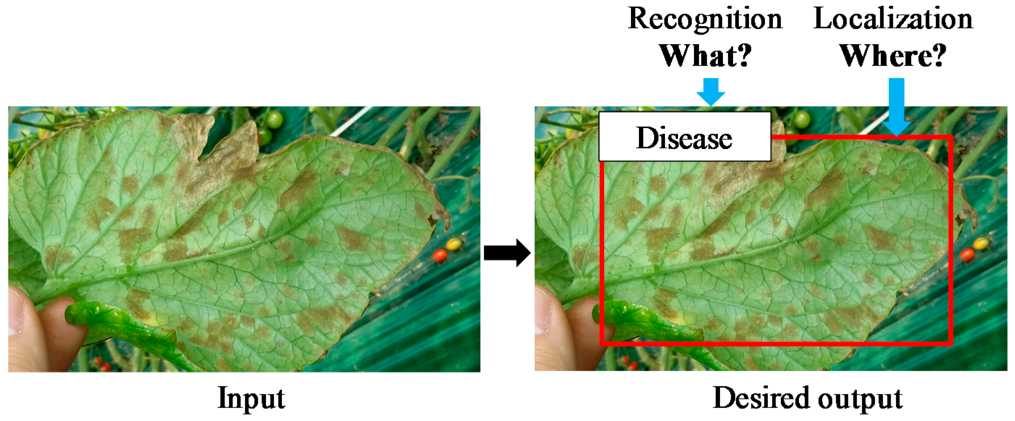

Slide 4
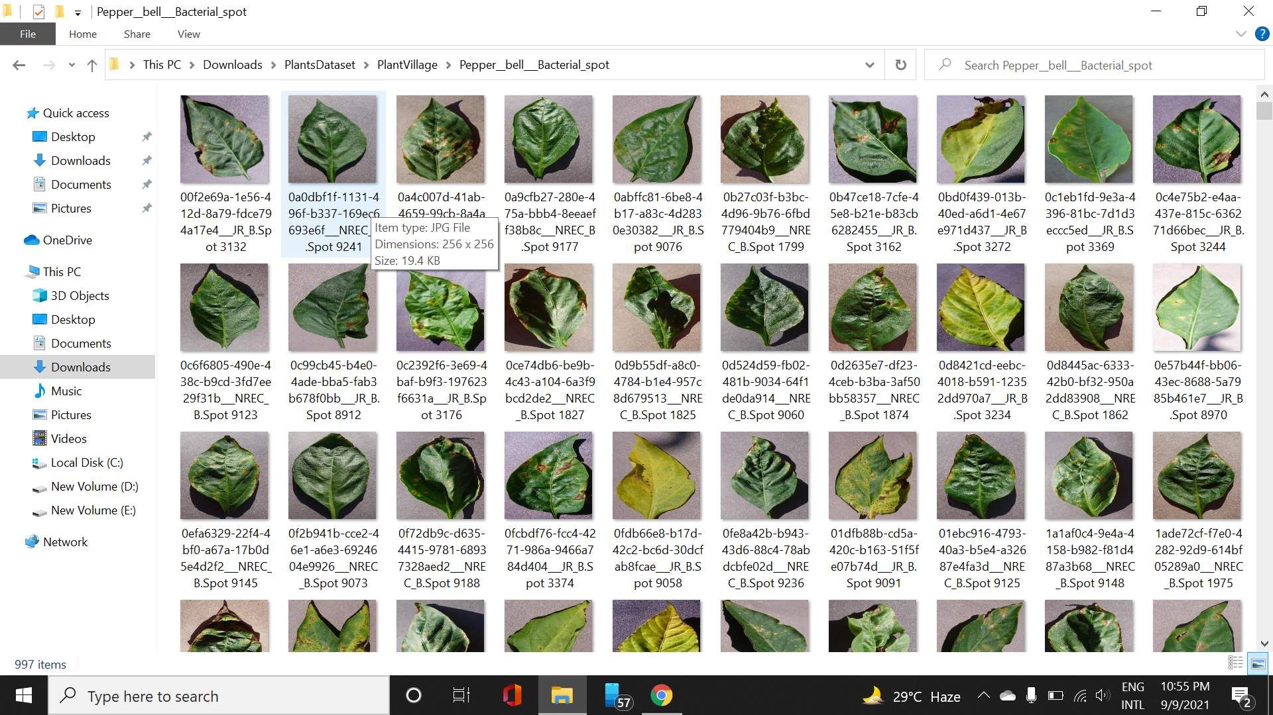
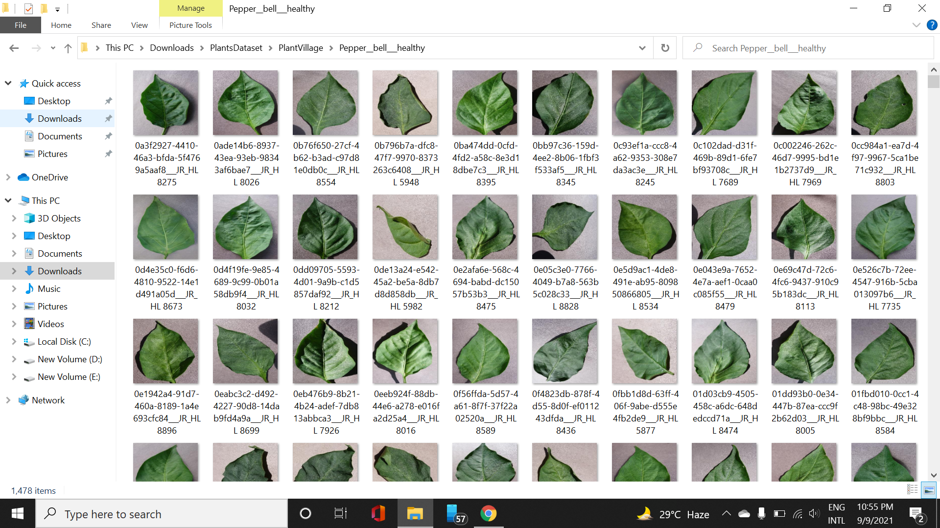
Leaf of Diseased Bell-Pepper Plant
Leaf of Healthy Bell-Pepper Plant

Slide 5
METHODOLOGY
yes
Input test Image
Preprocessing
Convert to an array for comparsion
Healthy
No
Defect
Segregated database
Preprocessing
Training model using CNN
CNN based classsification
Yes
Display disease name
Flowchart for disease detection

Slide 6
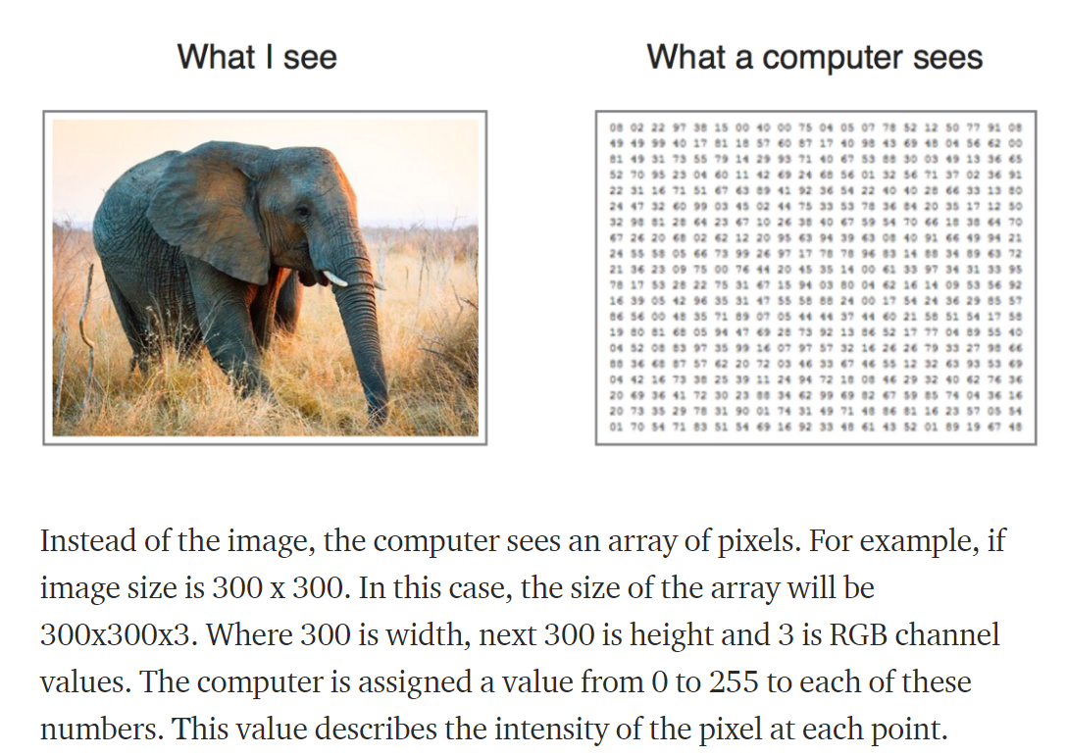
Image classification

Slide 7
Flask : Web application framework
Web Application Framework represents a collection of libraries and modules that enables a web application developer to write applications without having to bother about low-level.
Flask is a web application framework written in Python. Flask is based on the WSGI toolkit and Jinja2 template engine.
WSGI : Web Server Gateway Interface (WSGI) has been adopted as a standard for Python web application development. WSGI is a specification for a universal interface between the web server and the web applications.
Jinja2 : Jinja2 is a popular templating engine for Python. A web templating system combines a template with a certain data source to render dynamic web pages.

Slide 8
Virtual Environment
virtualenv is a virtual Python environment builder. It helps a user to create multiple Python environments side-by-side. Thereby, it can avoid compatibility issues between the different versions of the libraries.
The following command installs virtualenv :
pip install virtualenv
To activate corresponding environment, use the following :
venv/Scripts/activate
We are now ready to install Flask in this environment.
pip install Flask

Slide 9
Flask – Routing
Modern web frameworks use the routing technique to help a user remember application URLs. It is useful to access the desired page directly without having to navigate from the home page.
The route() decorator in Flask is used to bind URL to a function. For example −
@app.route(‘/hello’)
def hello_world():
return ‘hello world’
Here, URL ‘/hello’ rule is bound to the hello_world() function. As a result, if a user visits http://localhost:5000/hello URL, the output of the hello_world() function will be rendered in the browser.

Slide 10
Flask – HTTP methods
Sr.No. | Methods & Description
1 | GET Sends data in unencrypted form to the server. Most common method.
2 | POST Used to send HTML form data to server. Data received by POST method is not cached by server.
3 | PUT Replaces all current representations of the target resource with the uploaded content.
4 | DELETE Removes all current representations of the target resource given by a URL

Slide 11
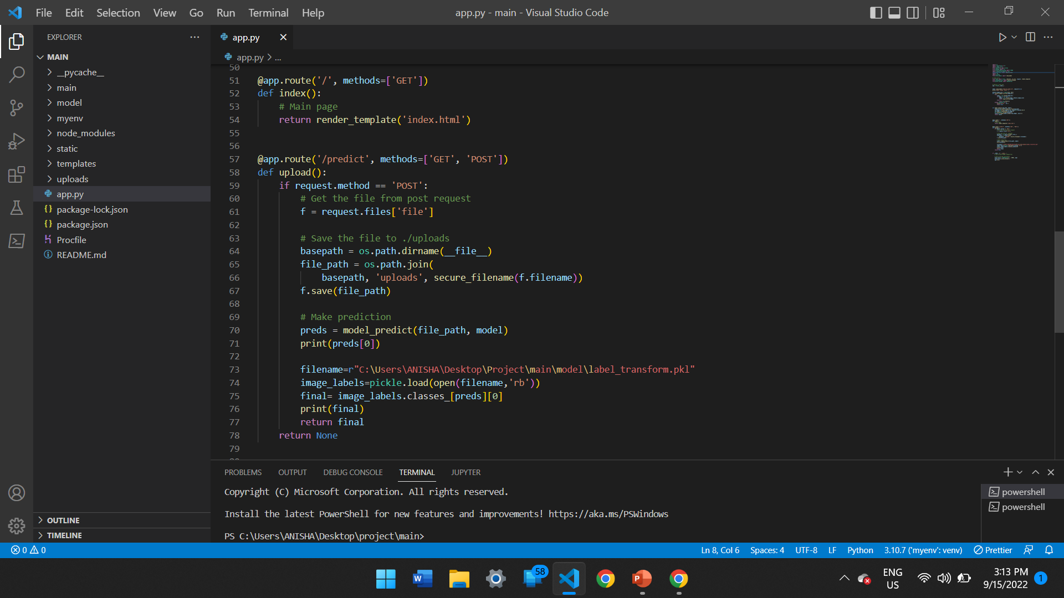

Slide 12
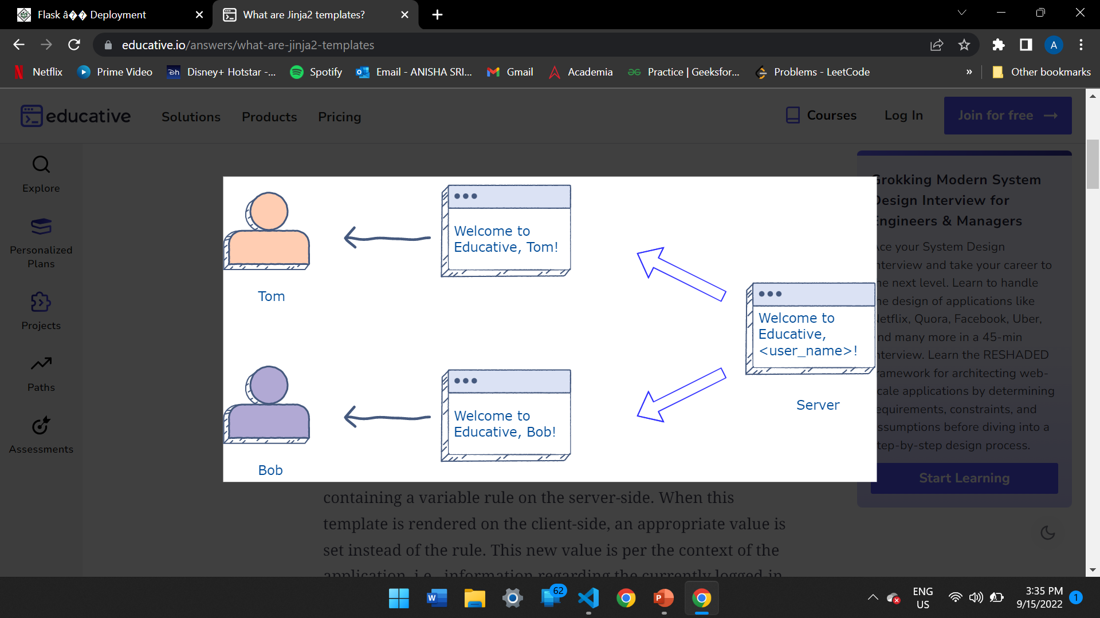
Templates
In a scenario where we have an application that provides services to many users, we want some personalization for each user on the platform. Dynamic templates help us to serve a unique template containing the content corresponding to the user.

Slide 13
Flask – Static Files
A web application often requires a static file such as a javascript file or a CSS file supporting the display of a web page. Usually, the web server is configured to serve them for you, but during the development, these files are served from static folder in your package and it will be available at /static on the application.

Slide 14
Flask – WTF
One of the essential aspects of a web application is to present a user interface for the user. HTML provides a <form> tag, which is used to design an interface. A Form’s elements such as text input, radio, select etc. can be used appropriately.
Disadvantage of using HTML form is that it is difficult (if not impossible) to render the form elements dynamically. HTML itself provides no way to validate a user’s input.
This is where WTForms, a flexible form, rendering and validation library comes handy.

Slide 15
Using Flask-WTF, we can define the form fields in our Python script and render them using an HTML template. It is also possible to apply validation to the WTF field.
For example, a form containing a text field can be designed as below −
from flask_wtf import Form
from wtforms import TextField
class ContactForm(Form):
name = TextField("Name Of Student")
WTForms package also contains validator class. It is useful in applying validation to form fields such as DataRequired, email, length, etc.

Slide 16
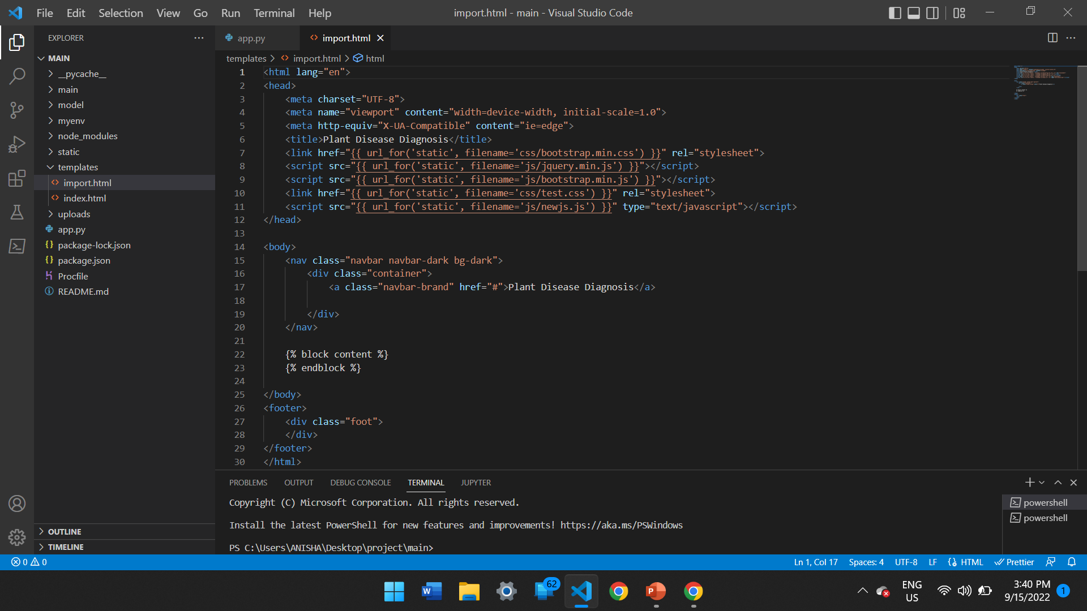
Screenshots
Screenshot aside shows template named “import.html”
This template extends every html page which requires similar data or page structure.
Here, ‘{% block content %}’ is used to provide content which is different for all web pages.

Slide 17
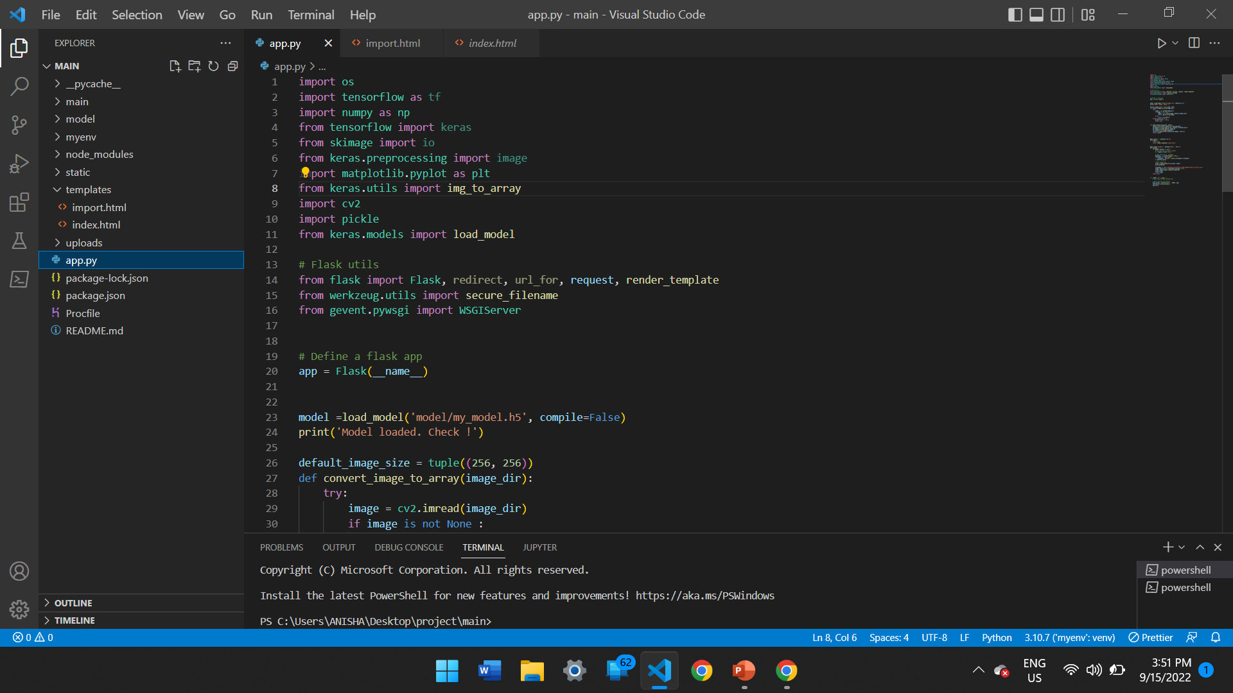
Imports required to run application smoothly on WSGI Server.

Slide 18
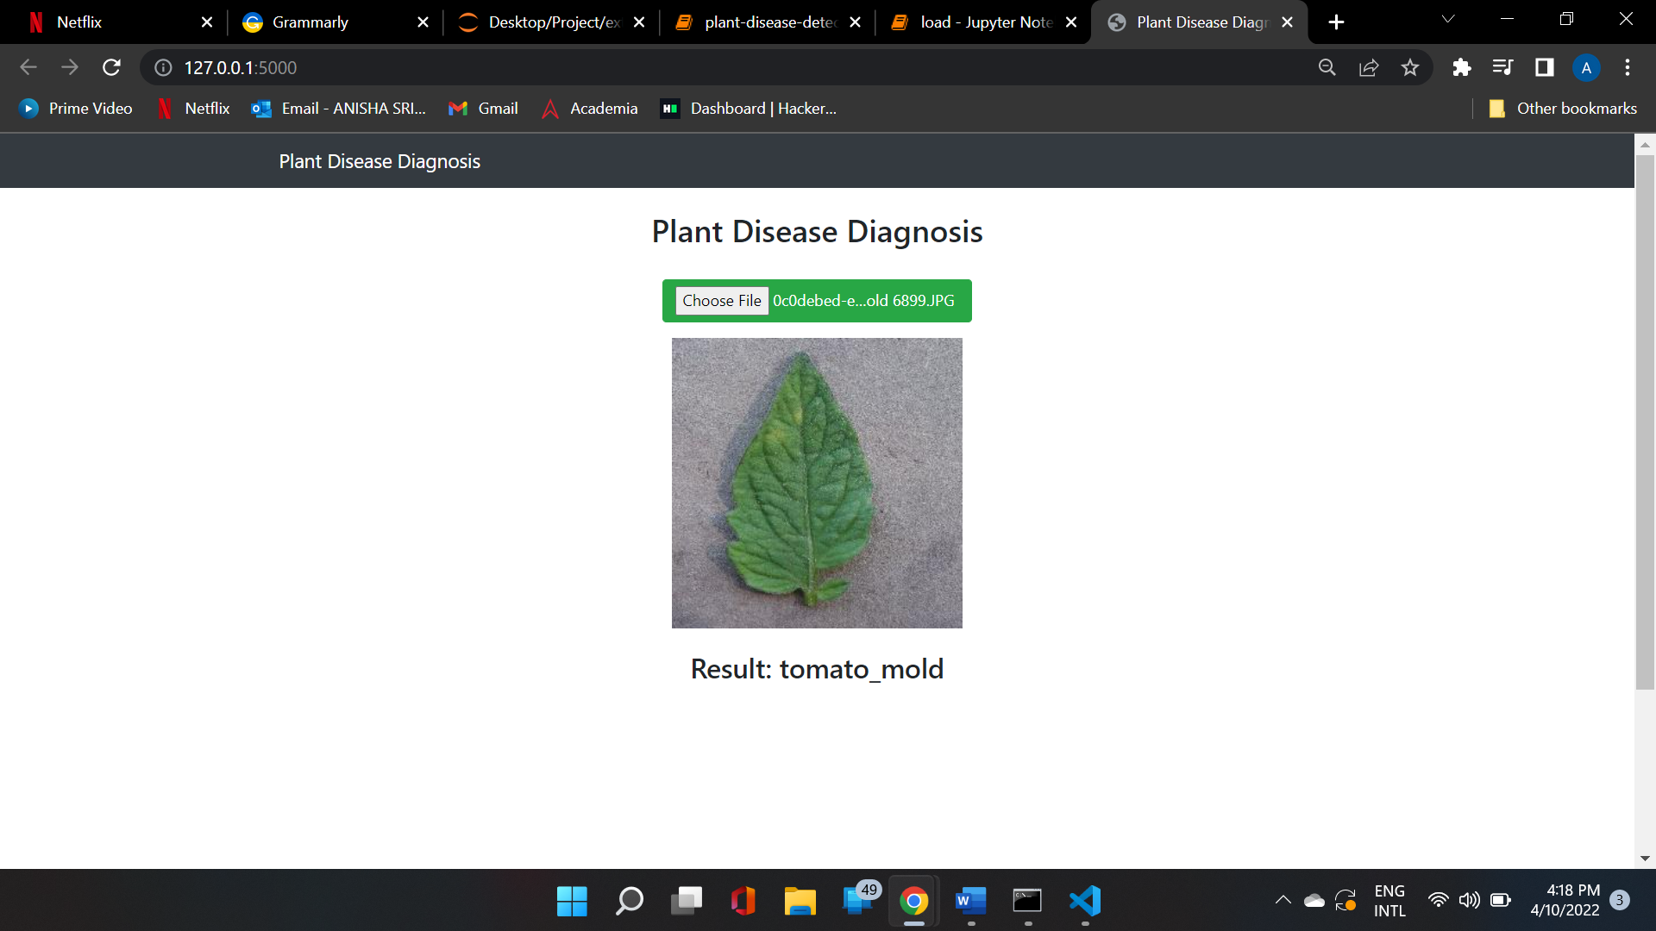
Implementation

Slide 19
